Slide 1
CUSTOMER CHURN PREDICTION ANALYSIS

Slide 2
DATA PREPROCESSING
In the domain of customer churn prediction, accurate analysis is pivotal for businesses to retain customers. Data preprocessing plays a critical role in ensuring the quality, accuracy, and relevance of the data used for building predictive models. Below are the key steps involved in the data preprocessing phase of customer churn prediction analysis:
First we have to collect the data from the excel file attached in the mail and want to make table using pandas library.

Slide 3
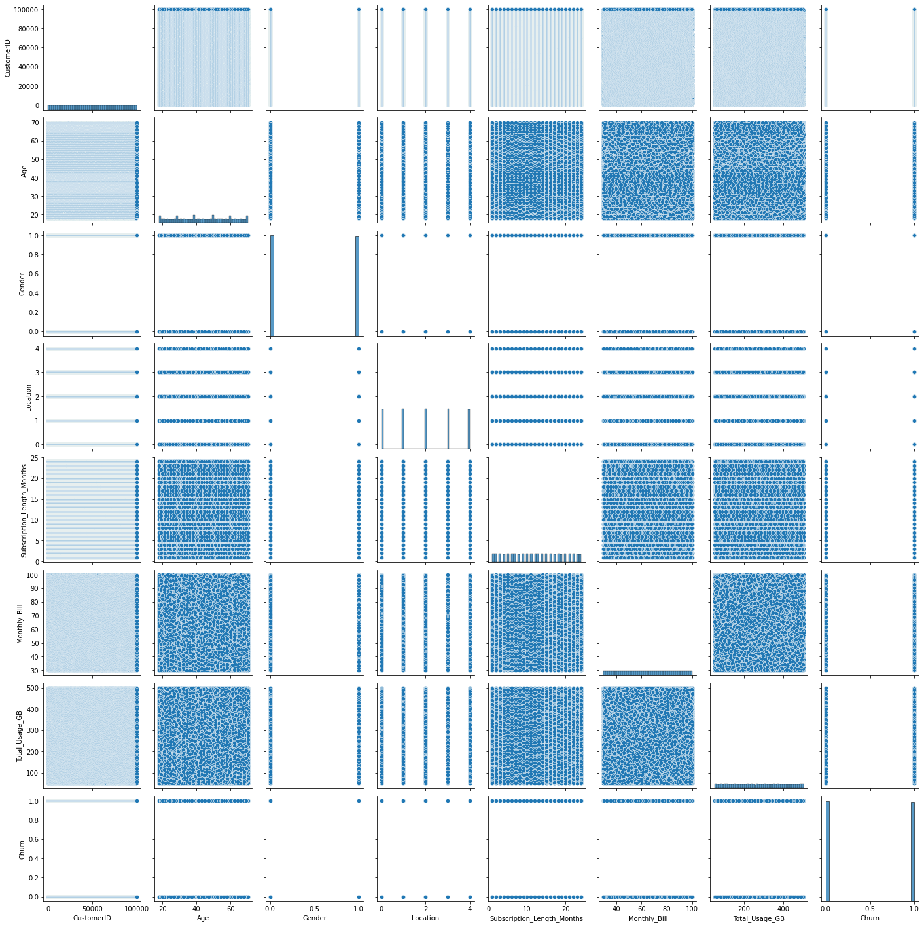
Pairplot for the dataset

Slide 4
Handling missing data
Now I did explonatory data analysis using pandas library and scipy model to check whether there is outliers.
Initially I dropped customer name because it wont effect prediction later I used encoding technique to convert string data into numerical data.
Now I have started checking above key lines
If there is any missing data
If there is any outliers
If there is any null values
For the above questions I have used padas library and python.
In the above picture we can look missing data

Slide 5
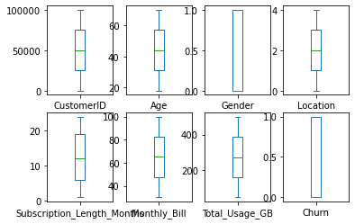

Slide 6
Now I moved to next step to drop names column later started encoding technique for both gender and location columns and changed to numerical data
I found that there is no outliers in the file , I used zscore to check whether there is outliers. I assigned threshold value to 3 , the value above 3 can be treated as outlier so I checked if there is any outliers but there is no outliers.
Categorical variables, a common presence in real-world datasets, require transformation into numerical format for compatibility with machine learning algorithms. Utilizing techniques like one-hot encoding or label encoding, here I used label encoding the categorical variables were appropriately converted to numerical representations without compromising the integrity of the data.

Slide 7
Feature engineering
In the context of enhancing customer churn analysis, feature engineering plays a pivotal role in improving the efficacy of predictive models. A specific technique that proves valuable is Synthetic Minority Over-sampling Technique (SMOTE). This note provides a concise overview of how feature engineering, particularly utilizing SMOTE, contributes to more robust customer churn prediction models
The dataset of target column looks imbalanced I checked using countplot
Now using smote model I balanced the dataset
I have given the image of balanced dataset

Slide 8
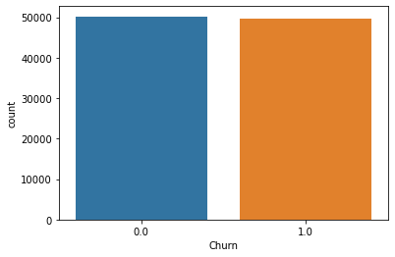

Slide 9
Model building
I used some supervised models ,ensemblings models ,cross validation technique using logistic regression and hypertuing parameter using decision tree classifier.
Secondly I did splitting the data using model selection technique.
Later I tried to use SVM but it not yet worked ,I waited much time but svm algorithem not worked so I done with remaing algorithms,
I used for loop to multiple algorithms like logistic , gaussiannb, and decision tree classifer and I got values with prediction near to .50
Here we can see that the model was trained,splitted into training and testing models.

Slide 10
Model optimization
Moreover we can look into the values of f1 score ,accuracy,precision and recall.
I have used cross validation technique with guassianNB here I got the good prediction about 0.503 and this the best prediction value
I also used hyper parameter tuning model decision tree classifier I got value similar to cross validation but there difference.
Here I also calculted for all the techniques but the best prediction is cross validation with guassiannb.

Slide 11
Model deployment
Finally I saved the file into score file using joblib method and I gave a code to enter future values.
Here we got the prediction score of 0.503
The cross-validation score of 0.503 provides us with an understanding of the model's predictive capability. In this context, the score indicates that the model's accuracy in predicting customer churn is marginally better than random guessing
As we advance, our commitment remains focused on extracting meaningful insights from our data to drive effective customer retention strategies and ultimately reduce churn rates.

